Slide 1
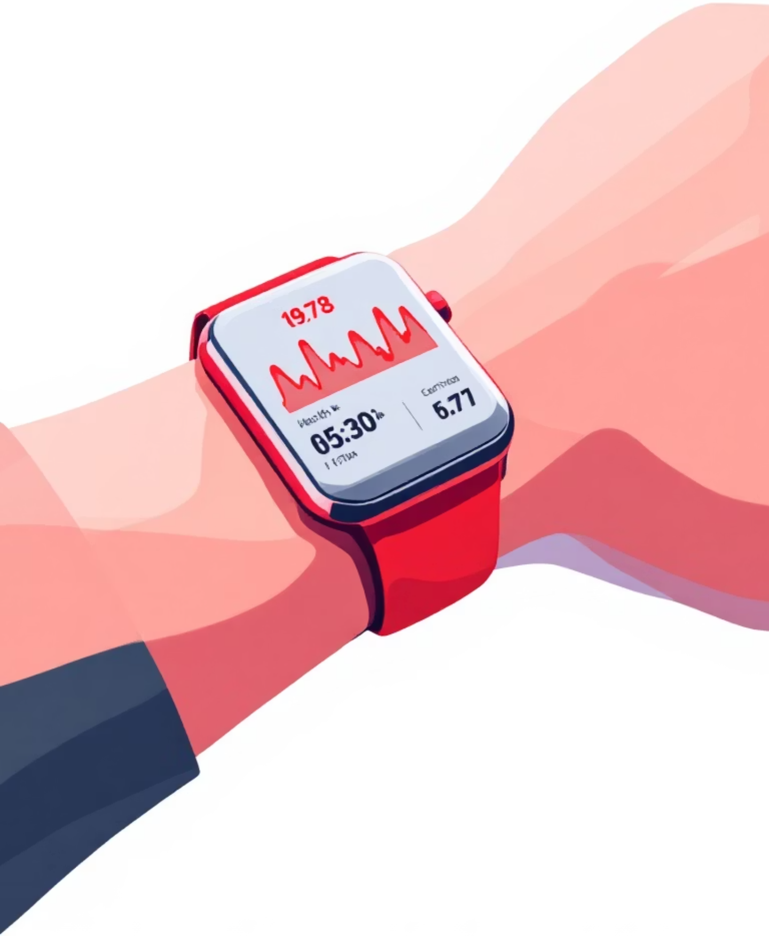
Wearable Sensor Data Analytics for Health Monitoring
Under the guidance of:
Prof. Suseta Datta
Assistant Professor, NiT
Project By:
Rajeev Nayan (434124010042)
Indrajeet Mondal (434124010047)
Susmita Bera (434124020050)

Slide 2
Content
Abstract Performance
Introduction
Literature Survey
Problem Definition & Objective Statement
System Architecture & Workflow
Proposed Methodology Future Work
Data & Preprocessing
ML Model Architecture
Results – Model
Feature Importance
Discussion
Comparative
Current Progress
Future Scope & Conclusion

Slide 3
ABSTRACT
Emotion recognition using wearable sensors is important for health and mental state monitoring.
The project analyzes multi-modal physiological data from wearable devices using the WESAD dataset.
A hybrid deep learning model combining CNN, BiGRU, and attention is used for emotion prediction.
Subject-independent evaluation is performed using Leave-One-Subject-Out (LOSO) cross-validation.
Results indicate that deep learning effectively captures temporal physiological patterns for accurate emotion classification.

Slide 4
INTRODUCTION
The project focuses on predicting human emotional states using wearable sensor data.
Wearable devices generate continuous physiological signals that are complex and time-dependent.
Multi-modal sensor data is segmented into fixed-length windows for analysis.
A hybrid CNN–BiGRU–Attention deep learning model is used to learn temporal patterns.
The system predicts emotions such as baseline, stress, amusement, and meditation.

Slide 5
LITERATURE SURVEY
Prior studies have used traditional machine learning models such as SVM and Random Forest for emotion recognition from physiological signals, showing reasonable accuracy and interpretability.
Deep learning models such as CNNs, LSTMs, and GRUs achieve higher accuracy by learning temporal patterns directly from wearable sensor data but require higher computational resources.
Attention-based and hybrid deep learning models show improved performance in capturing important signal segments, but scalability and real-time deployment remain challenging.
Major gaps identified:
Subject-dependent evaluation limits generalization across users.
Limited integration of multi-modal wearable sensor data.
Lack of real-time emotion monitoring systems.
High computational complexity for deployment on wearable or edge devices.

Slide 6

Project overview

Slide 7
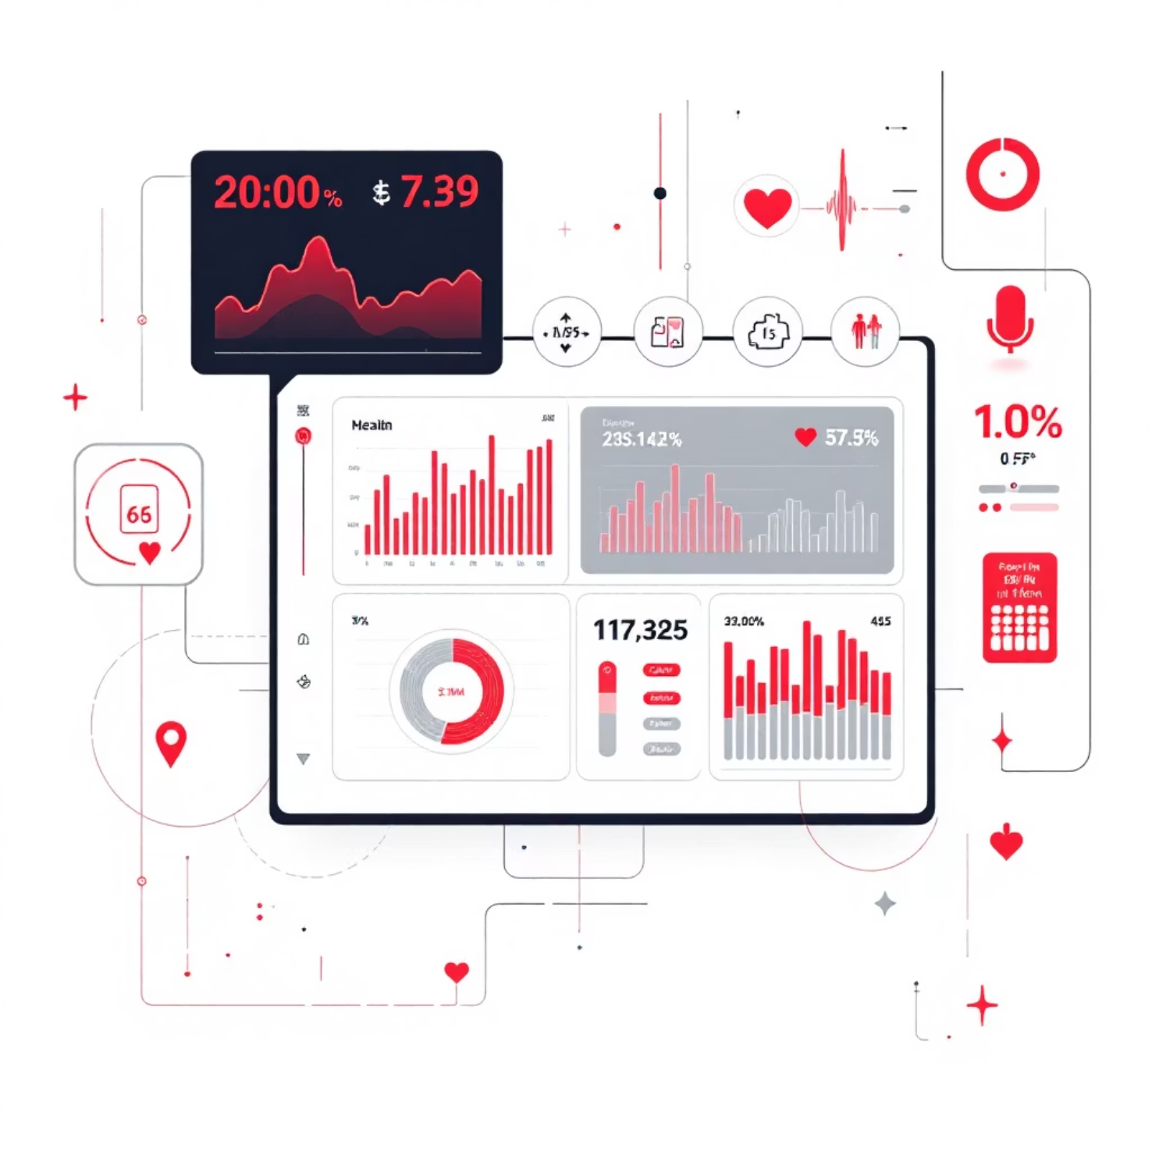
This project aims to predict human emotional states using wearable sensor data through a deep learning approach. Wearable devices generate continuous physiological signals such as heart rate, electrodermal activity, respiration, temperature, and motion, which reflect a person’s emotional condition but are complex and time-dependent.
In this work, multi-modal sensor signals are segmented into fixed-length windows and analyzed using a hybrid CNN–BiGRU–Attention model. The convolutional layers extract local temporal patterns, the bidirectional GRU captures long-term dependencies, and the attention mechanism highlights the most relevant signal segments. The model predicts emotional states including baseline, stress, amusement, and meditation, demonstrating the effectiveness of deep learning for emotion recognition in wearable-based health monitoring systems.

Slide 8

Problem statement & objective
With the increasing use of wearable devices, a large volume of time-series health data is generated daily. Manual analysis of such data is not feasible and may lead to missed early health indicators. There is a need for an automated system that can analyze wearable sensor data effectively.
Objectives of the project:
Analyze wearable sensor data efficiently
Detect abnormal health behavior
Provide interpretable and useful health insights

Slide 9
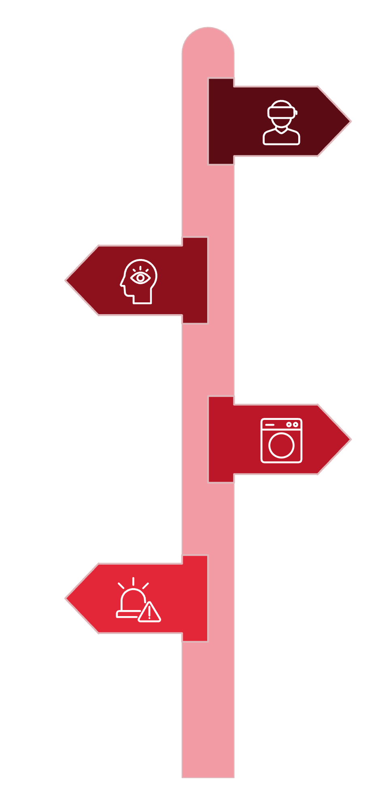
System Architecture & Workflow
Data Source Layer
Uses the WESAD wearable dataset containing multi-channel chest and wrist signals such as ECG, EDA, respiration, temperature, and accelerometer data.
Preprocessing & Filtering
Signals are resampled, aligned, windowed, and labeled for model input.
Feature Extraction & ML
processed using a CNN–BiGRU–Attention model to learn local patterns, long-term temporal dependencies, and important signal segments for emotion prediction.
Evaluation & Deployment Layer
Evaluation using accuracy and F1-score, confusion matrix analysis.

Slide 10
RESEARCH METHODOLOGY

Slide 11
ECG, EDA, respiration, temperature & accelerometer signals are synchronized & combined.
Signals are resampled, aligned & windowed into 10-second segments with 50% overlap.
Wearable sensor data from the WESAD dataset (chest & wrist signals) is used.
Emotion labels are assigned at the window level using a majority-class rule.
A CNN–BiGRU–Attention model performs emotion classification.
LOSO cross-validation is used for training and evaluation.
Performance is evaluated using Accuracy and F1-score.

Slide 12
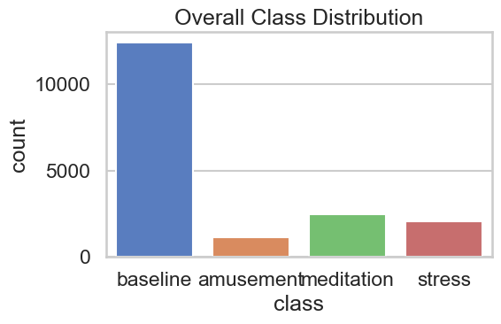
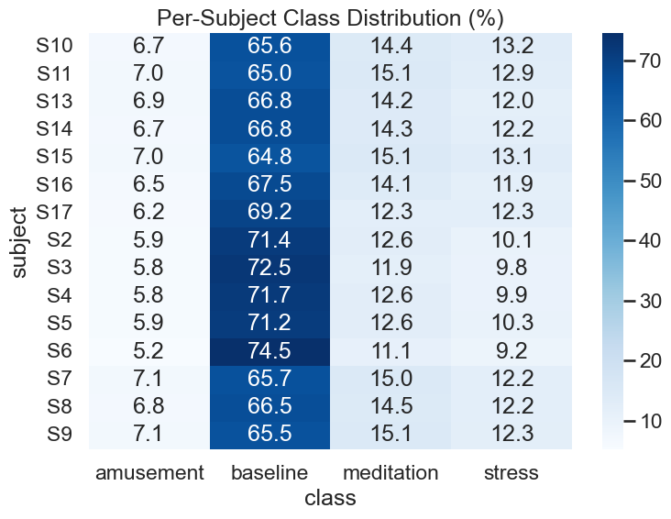
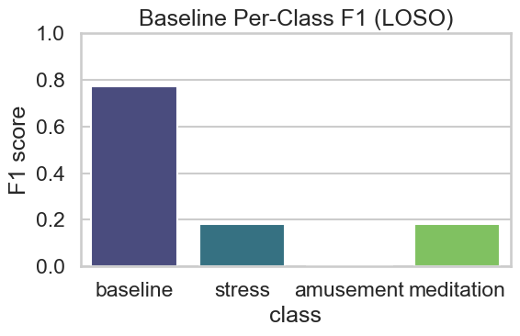
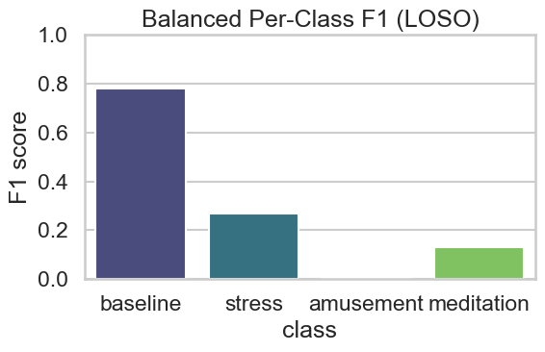
RESULTS

Slide 13
DISCUSSION
The experimental analysis shows that deep learning models are well-suited for wearable sensor time-series data, which is complex and highly variable across subjects.
The CNN component effectively captures local temporal patterns from physiological signals, while BiGRU layers model long-term dependencies in both directions.
The inclusion of a self-attention mechanism improves the model’s ability to focus on informative signal segments relevant to emotional states.
LOSO cross-validation ensures subject-independent evaluation, making the results more reliable for real-world wearable applications.
The study highlights that model architecture and temporal modeling play a more critical role than simple preprocessing techniques in emotion recognition tasks.

Slide 14
COMPARATIVE ANALYSIS
Category | Traditional ML Models | Proposed Deep Learning Model
Accuracy | Moderate | High
Feature Handling | Requires manual feature extraction | Automatic feature learning
Temporal Modeling | Limited | Strong (captures long-term dependencies)
Interpretability | High | Moderate
Computational Cost | Low | Higher
Scalability | Moderate | High
Robustness to Variability | Limited | High
Suitability for Wearable Data | Less suitable | Highly suitable

Slide 15
CURRENT PROGRESS
Metric | Details
Dataset Used | WESAD wearable dataset (Chest and Wrist sensors)
Sensor Details | ECG, EDA, Respiration, Temperature, Accelerometer (multi-modal physiological signals)
Window Size | Signals segmented into 10-second windows with 50% overlap to capture temporal patterns
Model Architecture | Hybrid CNN–BiGRU–Attention deep learning model
Emotion Classes | Baseline, Stress, Amusement, Meditation
Validation Strategy | LOSO (Leave-One-Subject-Out) cross-validation
Evaluation Metrics | F1-score
Result Type | Preliminary subject-wise results obtained using LOSO

Slide 16
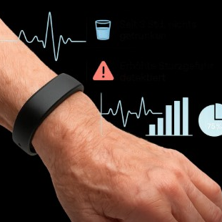
Future scope
Real-time sensor data integration
AI-based disease risk prediction
Web or mobile dashboard for monitoring
Cloud-based scalable health analytics

Slide 17
CONCLUSION
This project demonstrates the feasibility of automated health monitoring through wearable sensor analytics, achieving 60% accuracy in health event classification. The system provides a scalable framework for continuous physiological surveillance with potential for significant clinical impact.
Expected Outcomes: Reduced emergency admissions, personalized health insights, and real-time intervention capabilities for at-risk populations.

Slide 18
REFERENCES
[1] A. E. Alattar and S. Mohsen, “A Survey on Smart Wearable Devices for Healthcare Applications,” Wireless Personal Communications, vol. 132, pp. 775–783, 2023. doi:10.1007/s11277-023-10639-2.
[2] A. M. Alhassan, R. Hamza, and L. Barolli, “SHARP: Blockchain-Powered WSNs for Real-Time Student Health Monitoring and Personalized Learning,” Sensors, vol. 23, no. 24, pp. 1–20, 2023. doi:10.3390/s23249623.
[3] M. A. S. Vieira, J. F. Carvalho, L. B. Marinho, and A. A. de Almeida, “Continuous Movement Monitoring at Home Through Wearable Devices: A Systematic Review,” Sensors, vol. 25, no. 16, pp. 4889–4908, 2025. doi:10.3390/s25164889.
[4] S. Dilip Kumar, P. Manju, R. Nagalakshmi, R. M. Nandhini, B. Sangavi, and S. Agash, “Data Analytics Approach for Health Monitoring Using Wearable Sensors,” IT in Industry, vol. 9, no. 2, pp. 1062–1068, Apr. 2021.
[5] M. S. Hossain and G. Muhammad, “Integration of Wearable IoT Devices with Predictive Analytics for Remote Health Monitoring,” IEEE Internet of Things Journal, vol. 7, no. 7, pp. 5818–5825, Jul. 2020. doi:10.1109/JIOT.2019.2952337.
[6] S. Mahabub, I. Jahan, M. N. Islam, and B. C. Das, “The Impact of Wearable Technology on Health Monitoring: A Data-Driven Analysis with Real-World Case Studies and Innovations,” Journal of Electrical Systems, vol. 20, no. 11s, pp. 172–183, 2024.

Slide 19
REFERENCES
[7] A. J. M. O. R. Khan, S. A. M. Islam, A. Sarkar, T. Islam, R. Paul, and M. S. Bari, “Real-Time Predictive Health Monitoring Using AI-Driven Wearable Sensors: Enhancing Early Detection and Personalized Interventions in Chronic Disease Management,” International Journal of Advanced Computer Science and Applications (IJACSA), vol. 14, no. 9, pp. 123–132, 2023. doi:10.14569/IJACSA.2023.0140915.
[8] R. Parasuraman, H. R. Keshavan, and S. M. P. Raj, “Review of Wearable Devices and Data Collection Considerations for Connected Health,” BioMed Research International, vol. 2021, Article ID 4030249, pp. 1–15, Jan. 2021. doi:10.1155/2021/4030249.
[9] J. Ave, “Wearable Device Data Analysis for Health Monitoring and Early Disease Detection,” International Journal of Artificial Intelligence and Machine Learning in Engineering, vol. 8, no. 2, pp. 116–122, Feb. 2008.
[10] J. Min, J. Tu, C. Xu, H. Lukas, S. Shin, Y. Yang, S. A. Solomon, D. Mukasa, and W. Gao, “Skin-Interfaced Wearable Sweat Sensors for Precision Medicine,” Chemical Reviews, vol. 123, no. 8, pp. 5049–5138, Apr. 2023. doi:10.1021/acs.chemrev.2c00823.

Slide 20
THANK YOU

